Slide 1
The Lesk Algorithm and its Use in Word Sense Disambiguation
By Jonathan Westerfield
CSCE 221 – Section 201

Slide 2

Ambiguous Language
Machines cannot easily understand the human language
Ambiguous words
Ex. - “The trophy will not fit in my suitcase, it is too small”
Machines cannot use context and intuition to figure out what an ambiguous word is referring too
Designated an A.I. complete problem
To solve would mean to solve the central concept of A.I.

Slide 3
Word Sense Disambiguation
WSD for short
The process of removing the ambiguity from a phrase or text
Largely completed for the English language
Work is being done to try to finish it for other languages as well
A few languages currently being researched
Arabic
Hindi
Nepali

Slide 4
Generic Steps for Word Sense Disambiguation
Tokenization
Dividing the text into basic units or tokens called words
Part-of-Speech Tagging
Determining the grammatical category for each word that is found
Lemmatization
Morphological analysis of the words to find the root words, the ambiguous words
Chunking
Text is partitioned into syntactically correlated parts
Parsing
Providing the parse tree of the sentence structure

Slide 5
Some Algorithms That Are Used for WSD
Leacock & Chodorow,
Lesk
Wu-Palmer
Resnik
Lin
Jiang & Conrath

Slide 6
The Lesk Algorithm
Generally the most popular algorithm to use
Works to disambiguate the meanings of words
Finds the correct meaning of each word in context by individually locating the sense that overlaps the most between its dictionary definition and the given context
Takes each word individually, independent of the meaning of the other words occurring in the same context
Other methods simultaneously determining the meanings of all words in a given sentence or string

Slide 7
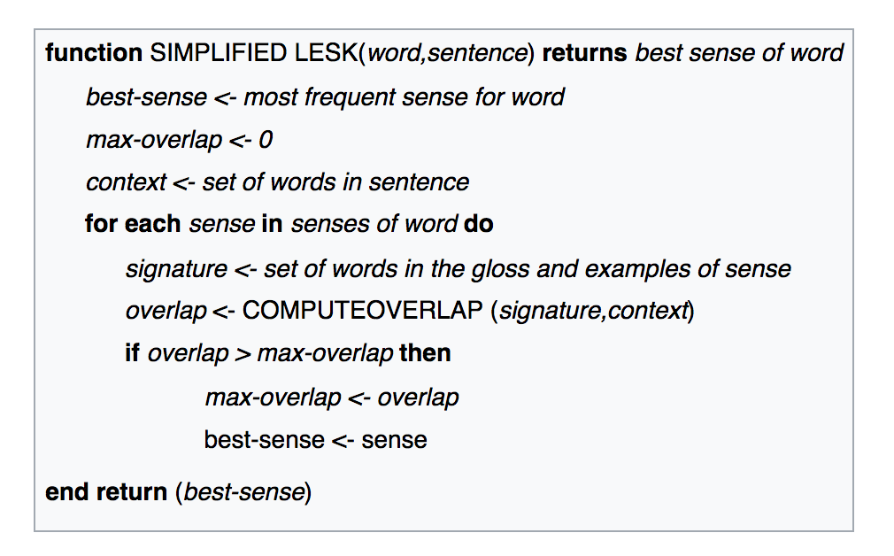
Lesk PsuedoCode

Slide 8
Disadvantages of the Lesk Algorithm
Very sensitive to the exact wording of the particular definition that is used
Accuracy can depend on the dictionary used
Will be different for differently worded definitions even if it means the same thing
Only uses the glosses of senses of the word being considered
A gloss is a series of brief explanations, such as definitions or pronunciations
This is a pitfall because the dictionary may not have a complete set of glosses or may not have an extensive enough set for the algorithm to use

Slide 9
Uses of the Lesk Algorithm and WSD
Search Engines
Google
Yahoo
Language Translation
Needed to make accurate translations between languages
Machine Learning and AI

Slide 10
Citation
Srinivas, Mulkalapalli, and B. Padmaja Ran. "Word Sense Disambiguation Techniques for Indian and Other Asian Languages: A Survey." International Journal of Computer Applications 156.8 (2016): 35-41. ProQuest. Dec. 2016. Web. 7 July 2017. <http://search.proquest.com/docview/1913919486?pq-origsite=gscholar>.

